Slide 1



SAP BUSINESS TECHNOLOGY PLATFORM TRAINING WITH CAPM S/4HANA Extensibility CLOUD FOUNDRY TRAINING
LIVE
www.anubhavtrainings.com

Slide 2








Agenda
01
Who is this course for?
04
What do we do today?
.
02
What is Cloud Foundry
FAQs
05
03
What is CAPM – Cloud Application Programming
Model
Q&A
06
www.anubhavtranings.com
2

Slide 3





www.anubhavtrainings.com
Who is this course for?
ABAP Developer-
Sumit Ghosh
Deliver new innovations that natively integrate with SAP applications like S/4HANA (Side by Side Extensions) on SAP BTP
Any Technical Consultant-
Neha Joshi
Work faster with latest development tools like Business application Studio and Frameworks like CAPM with Node JS.
BTP Developer-
Stevia Jack
Developing Applications Running on SAP BTP Using SAP HANA Cloud, Java and Node JS.
SAP Administrator-
Mohan Grava
Learn the security and administration of SAP BTP Cloud Applications. Understand connectivity basics and manage Central Fiori Launchpad in BTP.

Slide 4


Abraham
Software developer | Technical Advocate | SAP Enthusiast
Anubhav Trainings
AGE: 30
OCCUPATION: Technical advocate
EDUCATION: MS COMPUTER SCIENCE
Skills
1. ERP
2. Data structure
3. Programming language
4. Basics of SAP
01
02
Area of Work
SAP S/4 HANA, Fiori, ABAP, SAP Solution Architect
03
Needs
Design & architect systems
Provide Technical guidance
Develop end-to-end solutions in cloud
04
Aim
Build Side by Side extensions
Create new innovative Solutions
Plan BTP Strategy for your Company
www.anubhavtranings.com

Slide 5



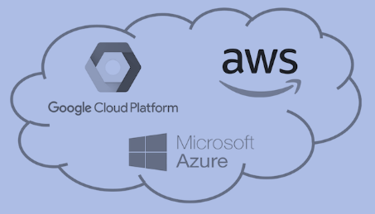
WHAT IS SAP BTP?
Application
Application
Data
Data
Runtime
Platform as a Service
Managed by SAP implementing open source CF
Middleware
Fully ready landscape with reusable services
Scalability
Elasticity
Low TCO
Database
OS
Managed by Infrastructure
providers
Data Centers
Service Portfolio
Virtualization
Infrastructure as a Service
Servers
Storage
Networking
www.anubhavtrainings.com

Slide 6
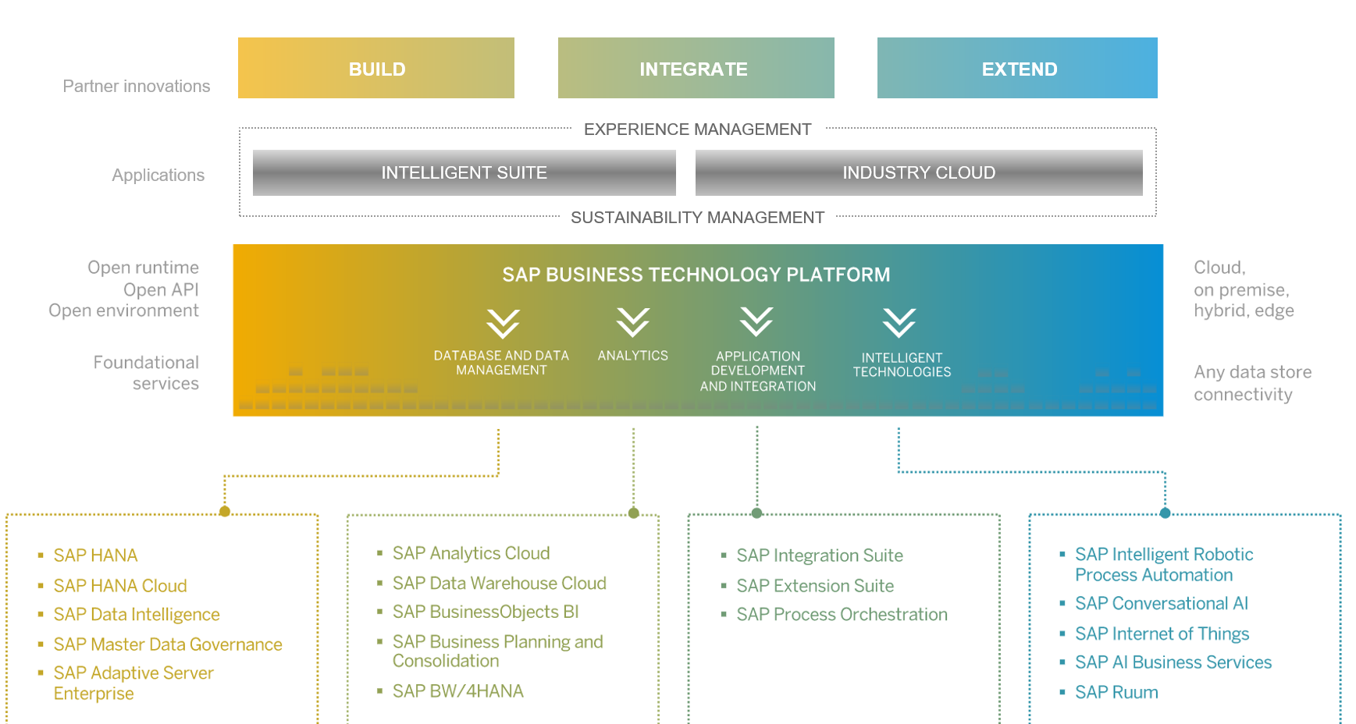
SAP BTP - Cloud Foundry Architecture
www.anubhavtranings.com
5

Slide 7
What is CAPM- Cloud Application Programming Model?
The SAP Cloud Application Programming Model is a framework of languages, libraries, and tools for building enterprise-grade services and applications
.
01
04
1. Framework – Programming Model based on CDS
4. Tools – Business Application Studio / VS Code
CAP-based projects benefit from a primary focus on the domain.
Develop code in an agnostic way.
.
www.anubhavtranings.com
02
03
2. Languages – Supports Node JS, Java as Open Source
3. Libraries & Kits - @sap/cds, @sap/cds-dk.
6

Slide 8

What do we do Today?
01. Start your development tool – Business App Studio
02. Initialize the project and add a Database Entity
03. Create a Service to expose the data
04. Annotate entity to display Fiori App
www.anubhavtranings.com

Slide 9
Source code access
https://anubhavtrainings.com/sapbtp03
Git repository link - https://github.com/soyuztechnologies/sapbtp03
Email – Anubhav.abap@gmail.com
Create your git account
Send email to Anubhav – Hello Anubhav, Please provide me access to our BTP course git repository https://github.com/soyuztechnologies/sapbtp03
My git user name is -> [your git user name]
Note: please only READ from repository, DO NOT push anything.

Slide 10
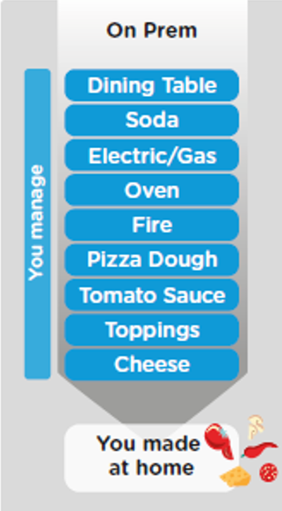
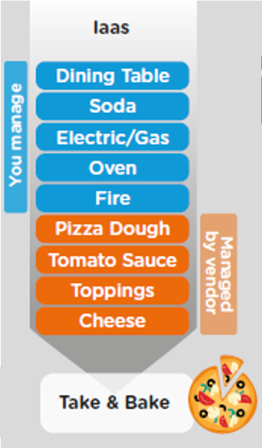
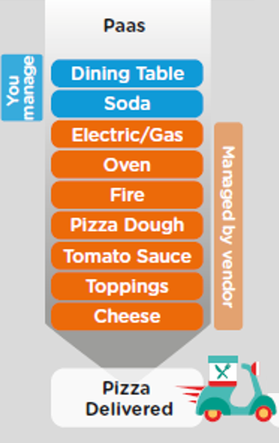
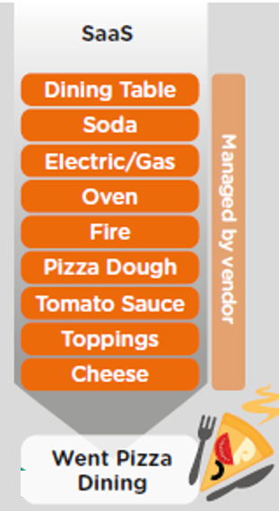
ON-PREMISE V/S CLOUD
www.anubhavtrainings.com

Slide 11
TYPE OF CLOUD OFFERINGS
Application
Application As a Service
Customer Managed
Customer Managed
Customer Managed
SAP Managed
Data
Runtime
Platform as a Service
SAP/Partner Managed
Middleware
Database
OS
Virtualization
Infrastructure as a Service
SAP/Partner Managed
Servers
Storage
Networking
www.anubhavtrainings.com

Slide 12
WHAT IS SAP CLOUD FOUNDRY?
Application
Application
Data
Data
Runtime
Platform as a Service
Managed by SAP implementing open source CF
Middleware
Fully ready landscape with reusable services
Scalability
Elasticity
Low TCO
Database
OS
Managed by Infrastructure
providers
Data Centers
Service Portfolio
Virtualization
Infrastructure as a Service
Servers
Storage
Networking
www.anubhavtrainings.com

Slide 13
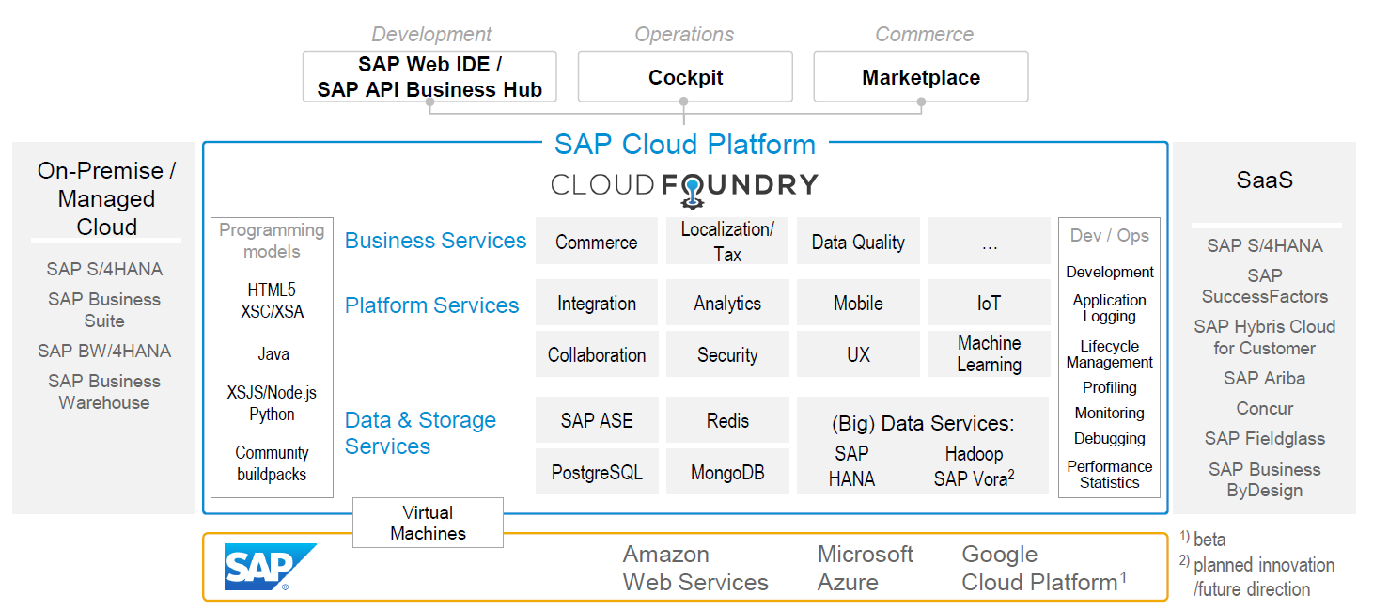
SAP CLOUD FOUNDRY ARCHITECTURE
SAP Business Application Studio
www.anubhavtrainings.com

Slide 14





Why CF (1)
1
Support full development lifecycle
Build Application & Services
Development
Continuous Delivery (CD) = Code 🡺 Push 🡺 Test 🡺 Build
Continuous Integration (CI) = Dev 🡺 Quality 🡺 Production
Up and Down
Deployment
Testing
Monitor and Upgrade
www.anubhavtrainings.com

Slide 15



Why CF (2)
2
Self healing container management system
Cell
Garden = execution
Containers
A
www.anubhavtrainings.com

Slide 16
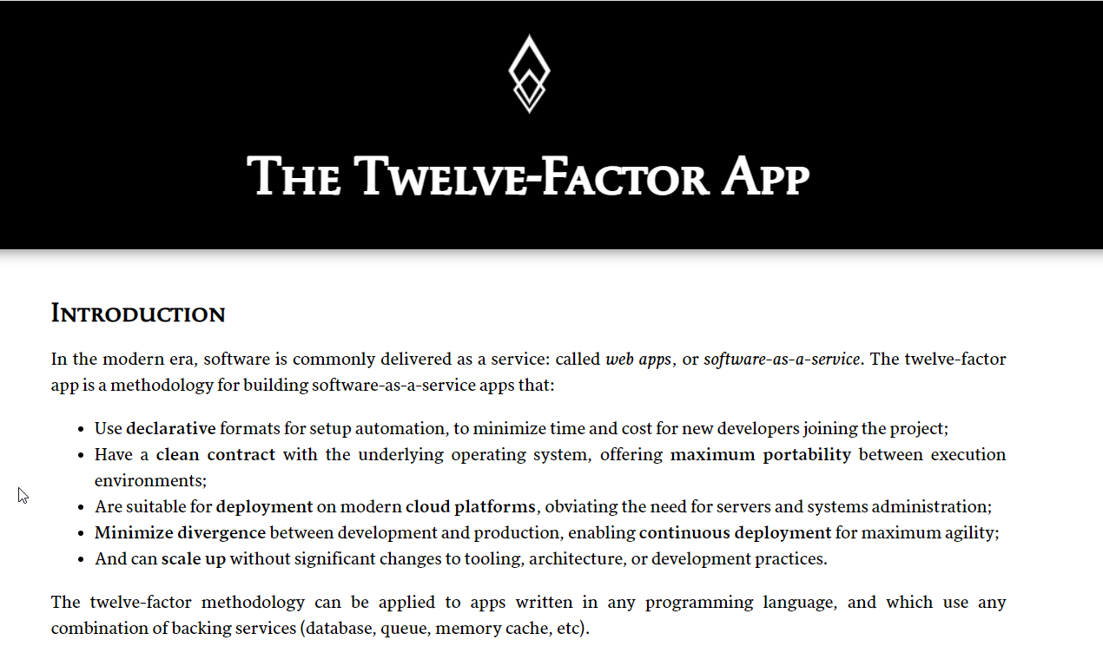

Why CF (3)
3
Support 12 Factor App
It is a strategy to build software-as-a-service
https://12factor.net/
A
www.anubhavtrainings.com

Slide 17
Microservice v/s Monolithic Architecture
20GB 🡪 100GB
UI
Classes
UI
Classes
FM
Enhance
FM
Enhance
Application is safe even one part (microservice) break down
We have choice of technology
Possibility to scale each microservice individually
UI
UI
Classes
Logic
FM
Enhance
Database
destination
connectivity
deploy
hana
www.anubhavtrainings.com

Slide 18
Uber

Slide 19
History of CF
License: Apache 2.0
Build in Ruby, Java and Go
Open Governance Foundation
2009-2011
2012
2013
2014
2015
2019
2021
VMWare
BOSH
Open Source Tools
Seven platinum members and two gold members
40+ Members
65+ Members
Jan 2021
Pivotal Cloud foundry closes free trials
Pivotal
EMC
VMWare
General Electric
www.anubhavtrainings.com

Slide 20
Organization of BTP CF
Directories
Additional grouping of subaccount to manage policies easily
Global Account
(Representation of a customer – used for billing purpose)
e.g. IBM, EY, Nvidia
Entitlements – Services which this customer opted for
5 – HANA
100 – CF Runtime
Sub Account
Per Region, Datacenter, IaaS
(Organization by the customer, how they want to split their services and development teams)
S1 – EU (2), S2 – SG, S3 – US(3)
Space
(It is the compute unit in which we actually deploy and run our application – it constructs our landscape for development)
DEV | QLT | PROD
Assigned with Quota
1..*
1..*
Here we assign entitlements which we got from global account to sub accounts to organize what is really needed at each sub account level
1..*
Apps
Apps
Apps
www.anubhavtrainings.com

Slide 21
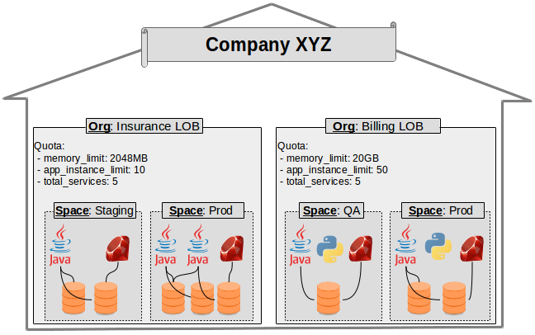
Customer View
www.anubhavtrainings.com

Slide 22
Exercise: Setup your FREE SAP Account
Create your SAP Account and SAP ID
https://sap.com
4 Hours from now for today’s video
Next Sat we don’t have a class as Anubhav will be going for team outing
Sunday we have a class.
www.anubhavtrainings.com

Slide 23
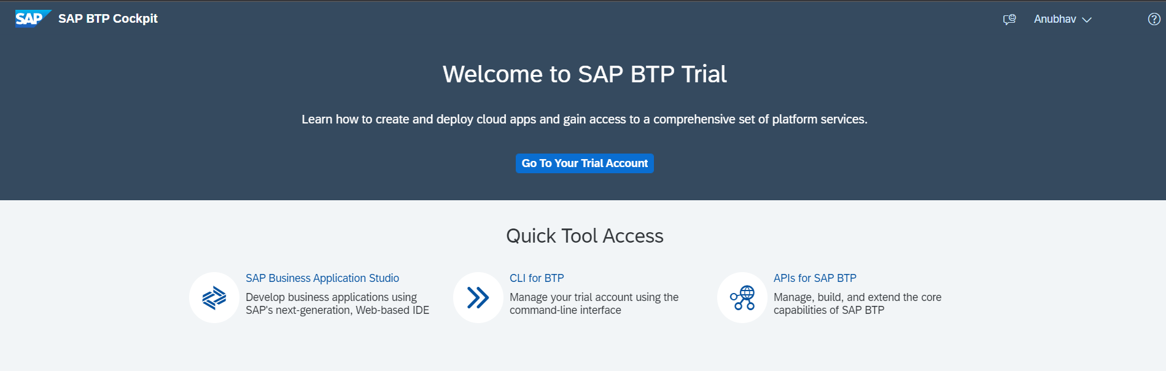
Setup Your FREE Account
https://account.hanatrial.ondemand.com/trial/#/home/trial
www.anubhavtrainings.com

Slide 24
https://discovery-center.cloud.sap/viewServices
Free Tier Account over free trial Account
https://developers.sap.com/tutorials/btp-free-tier-account.html

Slide 25

Environment, Subscriptions & Instances
Environments
Environments constitute the actual platform-as-a-service offering of SAP BTP that allows for the development and administration of business applications. Environments are anchored in SAP BTP on subaccount level.
SAP BTP offers three environments: ABAP, Cloud Foundry and Kyma. Some existing customers still have Neo, but this is no longer offered.
Subscription based services
You will also see these ones called software as a service (SaaS), or multitenant applications. The are environment specific. Each environment has its own organization (for users and applicatiexperience here is that you subscribe to the service, and in return you receive a URL, from which you can access that service. Opening the URL brings you to a web application from which you can leverage the service. This is how other SaaS like SuccessFactors or S/4HANA Cloud work as well. They are also enabled at a subaccount level, and are independent of the environments. You don’t need to have Cloud Foundry enabled to subscribe to SAP Launchpad Service, for example.
Examples include Launchpad, SAP Business Application Studio, Cloud Integration, Process Automation…
Instance based services
These are the purest services. They provide a specific functionality, like databases, connectivity, authentication…. You connect your application to them to leverage that functionality. These services don’t provide a UI to manage them. Instead, they rely on API to connect to applications and other services and provide their services. They are provisioned inside an environment, so they ons): In Cloud Foundry, instances are created inside a space. For Kyma, instances are created inside a namespace.
www.anubhavtrainings.com
Notes:
https://help.sap.com/docs/BTP/65de2977205c403bbc107264b8eccf4b/144e1733d0d64d58a7176e817fa6aeb3.html

Slide 26
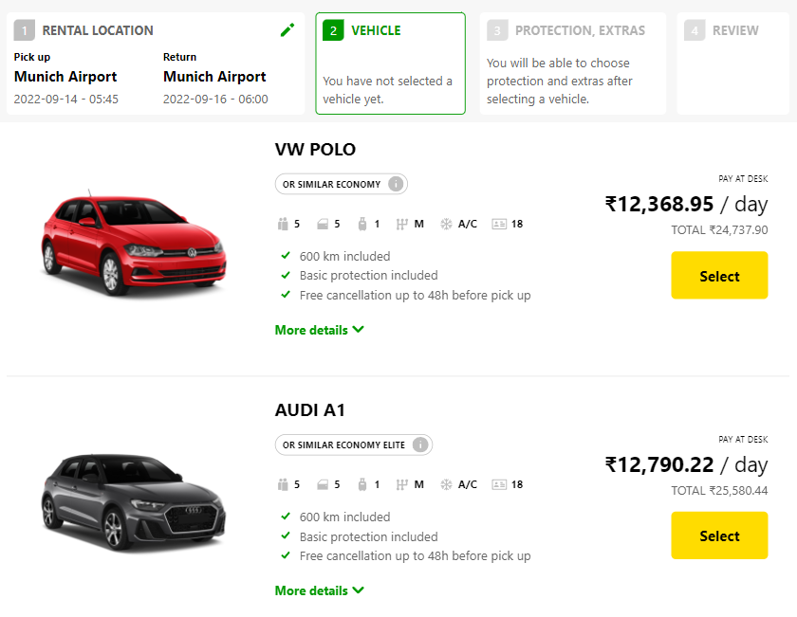
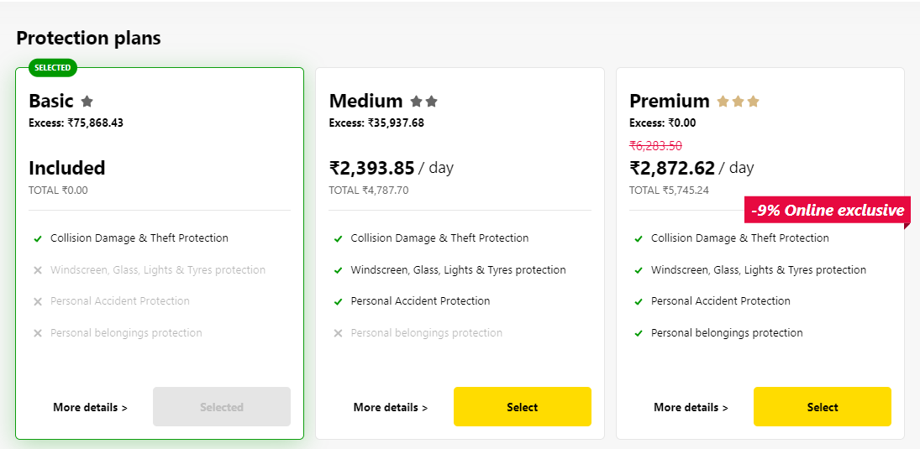
Backing Service
Each service has one or more service plans available. A service plan is the representation of the costs and benefits for a given variant of a particular service. For instance, a database may be configured with various "T-shirt sizes", each of which is a different service plan.
Choose Your service
Backing Service
Select Plan
Service Plan
www.anubhavtrainings.com

Slide 27


Backing service instance
Car key to use Car
Service Key to Consume Service instance
Actual Car
Service Instance
www.anubhavtrainings.com

Slide 28
BTP Service catalog
The SAP Discovery Center is a relatively new site hosted by SAP for developers and architects to find the services hosted by sap in SAP BTP and their respective service plans available.
It will also help technical team to identify the data center availability and cost associated with each service.
https://discovery-center.cloud.sap/#/serviceCatalog
www.anubhavtrainings.com

Slide 29
BTP Entitlement
Entitlements are the heart of all subaccounts in SAP BTP. They define which service and runtime artifacts you are able to use. When you purchase an enterprise account, you’re entitled to use a specific set of resources, such as the amount of memory that can be allocated to your applications.
An entitlement is your right to provision and consume a resource. In other words, entitlements are the service plans that you're entitled to use.
A quota represents the numeric quantity that defines the maximum allowed consumption of a resource. In other words, how much of a service plan you're entitled to use.
Entitlements and quotas are purchased and managed at global account level, from where they’re distributed to subaccounts, which consume them.
When you remove quotas or entitlements from a subaccount, they become available again at global account level and can be assigned to other subaccounts.
www.anubhavtrainings.com
Notes:
https://help.sap.com/docs/BTP/65de2977205c403bbc107264b8eccf4b/00aa2c23479d42568b18882b1ca90d79.html

Slide 30
Quota Plans
In the Cloud Foundry environment, you can further distribute the quotas that are allocated to a subaccount. This is done by creating space quota plans and assigning them to the spaces.
Space quota plans are optional and are used to limit how much each space can use, not to enable. If you don't create any space quota plans, all spaces in a subaccount using the Cloud Foundry environment have access to all entitlements and quotas in that subaccount. This means that one space could use up all the quota in a subaccount.
If you want to prevent that from happening and set a limit to how much each space can use from the total quota available in the subaccount, you can use quota plans and assign them to spaces.
www.anubhavtrainings.com

Slide 31
Business Application Studio
SAP Business Application Studio is a development environment available on SAP Business Technology Platform. Before you can start developing using SAP Business Application Studio.
In an Enterprise Account you can set up SAP Business Application Studio as a Free-Tier service by checking its free plan during its entitlement configuration.
The business application studio provides a dev space for developers to create private workspace to have pre-defined dependencies installed for creating particular type of applications e.g. sap fiori, Native HANA development, Cloud application programming development etc.
www.anubhavtrainings.com

Slide 32
Title
<>
www.anubhavtrainings.com

Slide 33
Tools and Installation
JRE and Node (Runtime)
JDK (jdk 11) - https://www.oracle.com/in/java/technologies/javase/jdk11-archive-downloads.html java -version
Node JS (version 18) - https://nodejs.org/en/download OR direct link
CF CLI (Command Line interface) to communicate with SAP BTP
https://github.com/cloudfoundry/cli/blob/main/doc/installation-instructions/installation-instructions-v7.md#installers-and-compressed-binaries
OR direct link
cf --help
Development tool – VS Code (free, offline, billions of dev) + Extensions (Java Extension pack, Spring Extension pack, Fiori Extension pack and SAP CDS language support)
https://code.visualstudio.com/download
4. Install postgresql database in local machine
https://www.postgresql.org/download/windows/
https://www.enterprisedb.com/downloads/postgres-postgresql-downloads
btp cli
Cf cli
www.anubhavtrainings.com

Slide 34
manifest.yml
This is a file which we must have to create as a developer to let sap btp know everything about our project properties like
App name
Size
Runtime environment – buildpack
Automatically allocate a URL – random-route
We can refer the documentation of writing this file
https://docs.cloudfoundry.org/devguide/deploy-apps/manifest-attributes.html
To deploy our first app to BTP
cf login in command prompt in vs code, provide sap btp a/c credentials to login
Choose dev space
cf buildpacks to know which runtimes are supported by BTP CF
cd <projectdir>
cf push to start deploying our app, which reads the manifest.yml file and deploys the app
cf logs <appname> command to check the log of our app
cf scale <appname> -i 2
cf scale <appname> -m 1024M
www.anubhavtrainings.com

Slide 35
Behind the scene
www.anubhavtrainings.com

Slide 36
Why we need frameworks to develop apps?
Framework – collection of libraries, classes, which contains ready to use patterns and code.
Framework – always used to standardize our complicated development in real-time. It outlines the golden rules which can be applied in the development of our application. There are many tasks which will be taken away from developer by the framework so the developer can focus on the domain knowledge and build application by writing minimal amount of code. E.g. CAP, RAP, BOPF. Node – Loopback, express, Nginx Java- Spring, EJB, Hibernate, struts
www.anubhavtrainings.com

Slide 37
Spring framework
It is a framework used by Java programmers in java language and helps us to develop complex applications like – UI based apps, cloud microservice based apps with security, cloud native apps, enterprise grade apps, web apps, portals etc.
Takes away lots of work from developer in-terms of creating and managing the objects of the class – IOC / Dependency injection
It provides runtime environment for complex microservice apps
Supports lifecycle methods
All the objects are loosely coupled
www.anubhavtrainings.com

Slide 38
Lose coupling and dependency
www.anubhavtrainings.com

Slide 39
Spring Boot
When we build a spring project, we need pivotal spring libraries in our computer, we need to know all dependencies, we need to create a project structure, make sure all dependencies etc. We can ask spring boot to initialize a project by telling our use case. Once the project is created, the maven will download the required libraries, we need to tell all libs which we want in pom.xml file to maven. Spring boot creates a project based on already proven project skeleton, it creates a production ready app.
www.anubhavtrainings.com

Slide 40
Title
<>
www.anubhavtrainings.com

Slide 41
Title
https://www.dataquest.io/blog/install-postgresql-14-7-on-windows-10/
https://get.enterprisedb.com/postgresql/postgresql-14.7-2-windows-x64.exe
Interface:
It’s a pure abstract class, has only the definition of functions
We will implement these functions in the classes
Interface brings reusability, @Runtime the child class object can be assigned to interface
www.anubhavtrainings.com

Slide 42
Use Case
My company recently implemented SAP BTP, they want to develop a microservice to manage all vendors and their addresses, So later this can be used by an android app to store data in cloud.
Properties for a vendor
- The class name should start with capital letter
- Java is case sensitive
- functions, attribute names must follow camel case
code
companyName
contactPerson
firstName
lastName
website
email
status
regDate
VendorController
(microservice)
VendorService
(manage all data)
Vendor (bean)
www.anubhavtrainings.com

Slide 43
Client Server Architecture
It describes, how the web based applications actually works
GET – Read data
POST – Create New Data
PUT – Update Data
DELETE – Remove data
Client
(Browser)
POSTMAN
Localhost:8080/vendors
Server
(all the logic and data) vendors
8080
Port
8080
Request (header + body(optional))
Response (header + body)
Text
Document
HTML
XML
JSON
servlet
PostgreSQL
https://youtu.be/NuNHxZOAqQM
www.anubhavtrainings.com

Slide 44
JSON – Java Script Object Notation
It is most used data format in the world today. It is a light weight data format to exchange data between systems as well on the web.
() – parenthesis {} - curly braces [] - bracket
{
prop: value,
prop: value,
prop: value,
….
}
We can validate json by https://www.jsonlint.com
Chrome browser plugin - https://chrome.google.com/webstore/detail/jsonvue/chklaanhfefbnpoihckbnefhakgolnmc
www.anubhavtrainings.com

Slide 45
DB integration with JAVA
1) JDBC (Java Database Connectivity) 2)JPA (Java Persistence API)
www.anubhavtrainings.com

Slide 46
Steps for DB Connection
Add the connection properties of our postgresql DB running locally
We need to add annotations in our POJO class to specify to JPA framework that our Vendor class is assumed to be DB table now and specify the columns of the database table. We can choose the name of the table as well as column names. We can additionally use predefined ID column which act as autogenerating primary key. GUID based database table design - https://www.youtube.com/watch?v=1tk4DUOXXQw&pp=ygUnc2ltcGxpZmllZCBkYXRhYmFzZSBkZXNpZ24gZ3VpZCBhbnViaGF2
We have to perform different database operations, So spring JPA provides JPARepository interface which we can inherit to create our own interface. It offers direct CURDQ functionality to perform DB operations.
Replace the hardcoding in service class with DB operations using the implemented Interface
Adapt the Controller functions to support the CURDQ functions and their return type
Add the @PostMapping function to testing Create of vendor
Download postman tool - https://www.postman.com/downloads/
www.anubhavtrainings.com

Slide 47
Application.properties
## default connection pool
spring.datasource.hikari.connectionTimeout=20000
spring.datasource.hikari.maximumPoolSize=5
## PostgreSQL
spring.datasource.url=jdbc:postgresql://localhost:5432/postgres
spring.datasource.username=postgres
spring.datasource.password=Welcome1
#drop n create table again, good for testing, comment this in production
spring.jpa.show-sql=true
spring.jpa.hibernate.ddl-auto=update
www.anubhavtrainings.com

Slide 48
Association
www.anubhavtrainings.com

Slide 49
Project Structure
Provides the reusable code to all the controller
Purely used for modularization
API layer – Checks, validate payload, interact with DB
Calls the JPA interface
@Entity
Vendor
@Entity
Address
/vendor
JpaRepository
Pivotal Spring JPA
Microservice
@RestController
VendorController
Service module
@Component
VendorService
Entity Manager Factory
microservice
Browser
IVendorPersistence
Transaction Manager Factory
POSTMAN
Microservice
@RestController
AddressController
Service module
@Component
AddressService
IAddressPersistence
Database Connection
Entity manager factory
Scan your package and read all the object (ORM) with annotation @Entity, it creates the database table for us in the connected database. It usage the jdbc driver of your database. Fires DDL commands
Transaction manager Factory
Manages all the transactions, trigger calls for insert, update, delete and query data. DML statements will be prepared and sent by this class.
https://docs.spring.io/spring-data/jpa/docs/current/reference/html/
Application.properties
postgre
www.anubhavtrainings.com

Slide 50
Challenges to deploy Spring App
Application (deployed)
cf push
Application
manifest.yml
-- Backing service
VS Code
Service binding
Postgre SQL
service-key
Postgresql
Local machine
SAP BTP - CF
AWS
AWS
AWS
www.anubhavtrainings.com

Slide 51
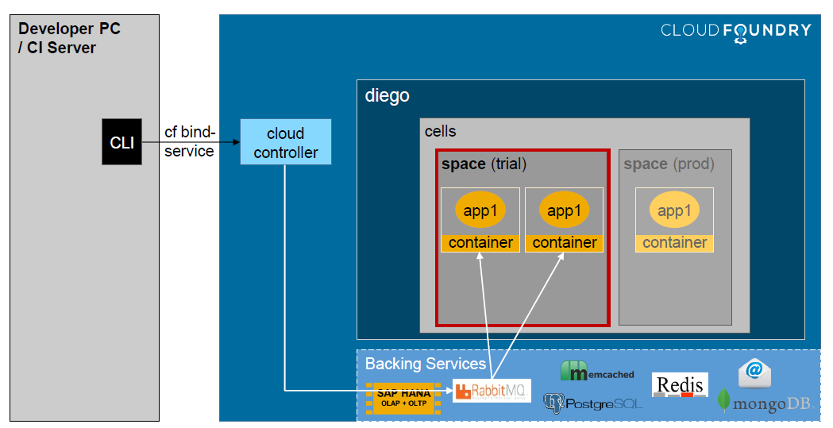
Backing Service Overview - Binding
www.anubhavtrainings.com

Slide 52
Running Spring App in BTP
Copy the project and change the name of the project and artefact id to new name
We need to start a backing service instance of PostgreSQL from subaccount. It is good practice to keep the name same what Anubhav training is keeping like mysql
We need to package our application and build a war file. This file we will deploy to cf by telling the address of this file in manifest.yml. We run command mvn clean install , once this command is executed, we will get the war file created in the target folder.
Since we want to deploy our application to sap btp cf environment, we need manifest.yml file
Next we need to login to cloud foundry environment using cf login and check build packs using cf buildpacks
Remove the content of application.properties file
Assuming that once our app is deployed to BTP, our app gets binded to the backing service in BTP which is named as mysql (postgre sql backing service), the BTP CF environment automatically creates the service key to use service instance by our app.
We never hardcode the db credentials in our application if we want to deliver a productive application to BTP. Because the credentials, and details might change for each environment, production, quality. We should attach to service key of our backing service at runtime. Our goal is to get these details at the time of deployment from service-key at runtime so our app can connect to db in cloud.
When we deploy app, the application binds to the backing service. At runtime the service key is made available to us in a environment variable called VCAP_SERVICES
www.anubhavtrainings.com

Slide 53
Create Backing service and connect
10. We need to use reusable java modules from maven to extract, parse, and pass and connect to our database running in cloud.
spring-cloud-cloudfoundry-connector
Spring-cloud-spring-service-connector
dbcp2- database connection pool module.
Eclipse link JPA – Receives the DB connection object and use that to pass it to the spring data jpa class. It also creates the object of entity manager factory and transaction manager factory class.
Slf4j – for logging purpose.
For hana connectivity
spring-cloud-hana-cloud-connector
spring-cloud-hana-cloud-service-connector
ngdbc – Database driver for hana db
11. Use the boilerplate code (remains fixed forever) to integrate dependencies, DbConfig, DBEntityFactory
12. Build our project by skipping tests = mvn clean install -DskipTests
13. We can check logs of deployed app – cf logs APPNAME --recent
Looking for cloud foundry VCAP_SERVICES variable and parse it. Passing this information to our own class. We must have to have a class in our project which inherits from standard class AbstractCloudConfig class.
Looking for cloud foundry VCAP_SERVICES variable and parse it. Passing this information to our own class. We must have to have a class in our project which inherits from standard class AbstractCloudConfig class.
www.anubhavtrainings.com

Slide 54
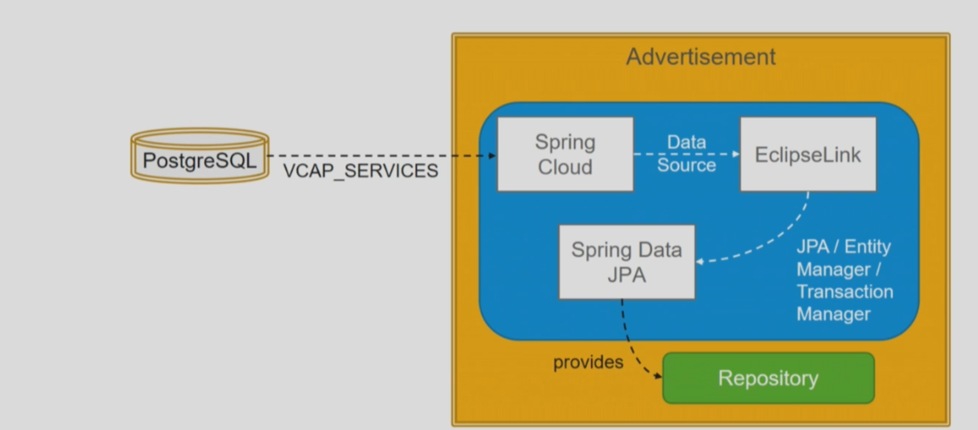
Access Environment Variable - Postgre
www.anubhavtrainings.com

Slide 55
Title
Local db
<>
pgadmin
mysql
www.anubhavtrainings.com

Slide 56
What is HANA
HANA Stands for High Performance Analytic Appliance, it’s a in-memory database by SAP.
Software and Hardware innovations
Drastic reduction in memory cost
Fabricated multi-core CPU (octa core processor)
Massive parallel processing
64-bit OS
Row vs Column store
Good compression
Partitioning
Data processing in specialized CPU caches
www.anubhavtrainings.com

Slide 57
How HANA organize its data
Schema – it is a mandatory database object, which stores other database objects like table, views, sequences, triggers, procedures.
Schema provides grouping and organization of db artefacts
Security – we can decide who can select, insert, update, delete, drop, create, alter database objects
Logical separation – multiple systems can connect to HANA db and they can create their own DB objects inside of HANA with a clear separations, this way we save the cost and optimum utilize data.
ECC
BW
S/4HANA
Schemas can be created statically or dynamically
In SAP BTP, we need to create first the SAP HANA cloud instance
We need to go to SAP BTP Cockpit and create a schema in HANA DB where we will store all our project data (spring boot project)
JPA can ultimately connect to this schema and store all our tables and data
When we want to connect to this schema our deployed BTP application usage service-key to connect to hana schema at runtime.
Like the postgre sql we have pgadmin tool to view objects, tables and schemas, sap HANA cloud provide a tool in btp called SAP HANA Database explorer tool to connect to our db and schema.
MARA
MARA
MARA
HANAX3X40k?
500GB
ECC 50GB
BW 150GB
S/4HANA – 200GB
MARA
MARA
MARA
www.anubhavtrainings.com

Slide 58
Title
<>
www.anubhavtrainings.com

Slide 59
OData Basics
Odata stands for Open data protocol it is the best way to create REST based services using open standard provided by Microsoft. OData has following advantages over plain REST service
It is best practice
Provides the metadata which helps developers to consume the OData $metadata
Can offer different payload types like XML, JSON etc.
All the capabilities of REST service
In SAP world, we use Fiori Applications, The Fiori apps understand oData directly
Fiori controls directly binds to the oData entities
oData is also a standard for building On-premise sap applications
There are different specifications available for odata
oData is gold standard for creating SAP UI5/Fiori Apps
Offers predicates like $top, $skip, $filter, $count
How it works
Odata Services consists of service document and metadata document. When we hit the main URL, we get the service document which describes all the entity sets. Each entityset is responsible for performing CURDQ (Create Update, Read, Delete and Query) operation. An entityset is created by an entity type which is the skeleton of the data. The service metadata document will show us all the entitysets and entity types. For example Vendor and Address are entity types which has properties like companyName, city, country, contactNo. Later we have entity set which is created on top of entity type, allowing us consumption of end points.
https://services.odata.org/
www.anubhavtrainings.com

Slide 60
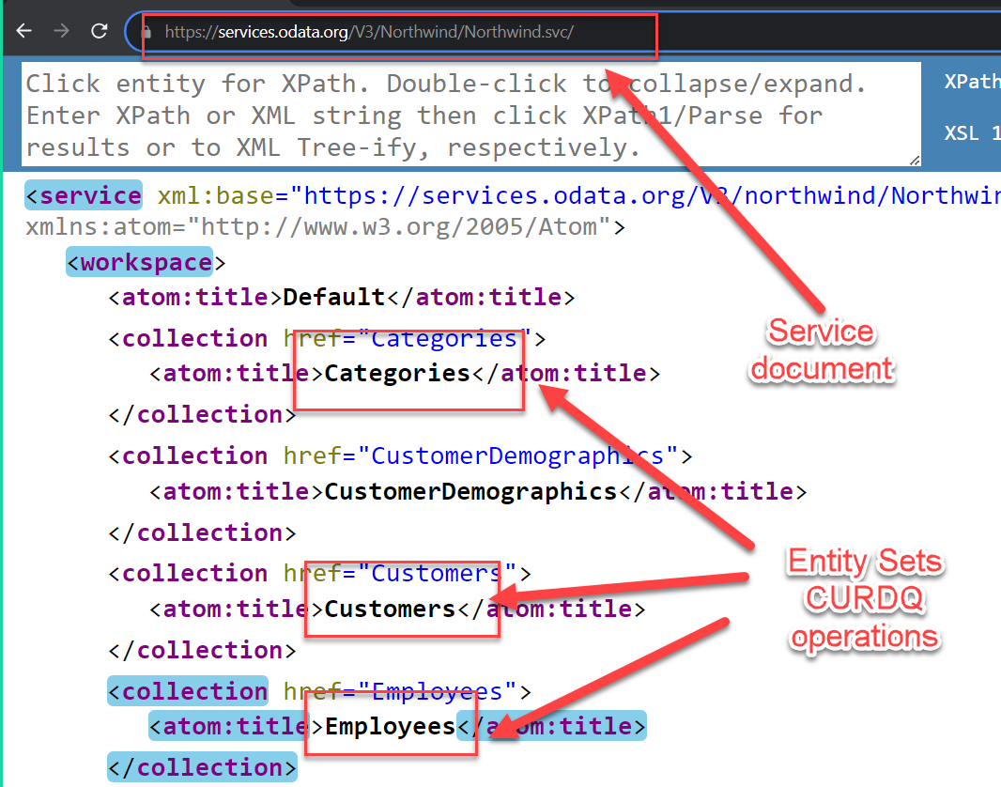
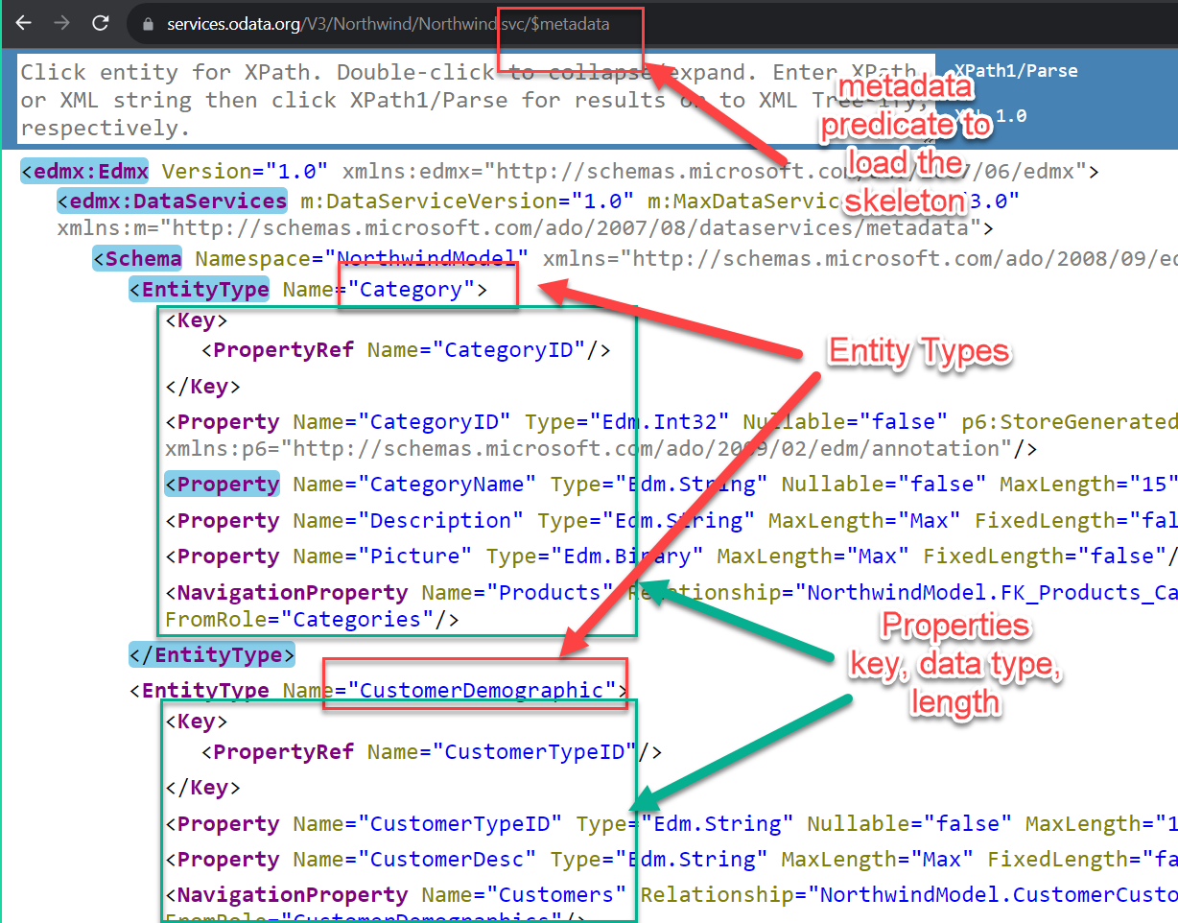
OData Know how
www.anubhavtrainings.com

Slide 61
OData Development using Java
There are frameworks available in market to develop OData services using java. Apache is one the company which provides one such framework which is an open source, the name of the framework is called as Olingo. It allows us to develop OData and also call Odata services using Java. An Odata service consists of and end point (service name), servlet, annotations, entities, connection details, runtime information and all the source code for performing CURDQ operation.
https://olingo.apache.org/
Boiler plate code = Standard reusable code provided by framework which a developer puts as it is in his/her project
ODataServlet
ODataServiceFactory
MyODataAnnotation
It provide metadata annotations for our odata
MyODataProcessor
All the request response header and body payloads are validated and processed
@WebServelet
OData Servlet
Provides the end point
/anubhav.svc
MyODataServiceFactory
Provides the object of Olingo implementation classes for our odata
Browser
Postman
ODataInterface
MyODataSource
Connection with JPA for Database connection and reuse of JPA entities
VendorODataHandler
AddressODataHandler
SpringUtils
www.anubhavtrainings.com

Slide 62
Steps to create OData
The code relevant for these steps will be in the notepad
Copy your existing project of btp – postgresql and rename project name
Add the pom dependencies to start using Olingo framework
Olingo Core – brings the core libraries of apache which offer the building blocks for odata
Olingo JPA – Already using JPA for DB interaction, so we can build on top of existing jpa project
Lombuk – which is also needed to generate setter and getters (internally used)
Create a class which inherits from ODataServlet to offer our odata end point
Modify our existing Application.java class to specify the packages related to Olingo framework boilerplate code which is responsible to drive odata engine. This will find all the Olingo specific code for handling and registering the odata handler classes for our entities.
Define a factory class MyODataServiceFactory which is responsible for producing objects of Olingo specific classes which handles the odata request response
Create 3 Odata management classes
MyODataAnnotation
It provide metadata annotations for our odata
MyODataProcessor
All the request response header and body payloads are validated and processed
MyODataSource
Connection with JPA for Database connection and reuse of JPA entities
www.anubhavtrainings.com

Slide 63
Title
Define the ODataInterface which contains the skeleton functions for CURDQ operations, later same will be used to provide the implementation of our respective entities
Next we provide marking in our ORM model entities to make them as EntitySets and EntityTypes for Odata service also each property marked with @EdmProperty annotation
Create Odata Agent classes which contains the final CURDQ code for our entities, these are equivalent of our DPC extension class in abap where we write the logic.
www.anubhavtrainings.com

Slide 64
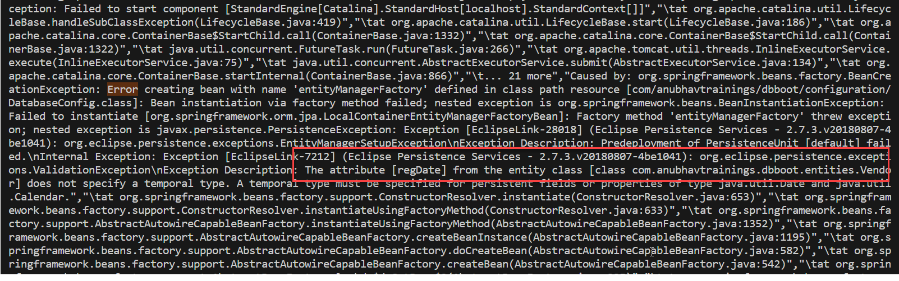
cf logs APP --recent
<>
www.anubhavtrainings.com

Slide 65
Full Stack Application
www.anubhavtrainings.com

Slide 66
Evolution of SAP UI Technologies
www.anubhavtrainings.com

Slide 67
SAP UI5
SAP UI5 is a framework to develop responsive web applications.
Framework – Collection of libraries
Library – Collection of classes
Class – Collection of properties, events, methods, aggregations
https://sapui5.hana.ondemand.com/#/api/sap.m.Button%23events
Responsive – a web application which adapt itself according to the devices.
MVC (Model, View and Controller) – inspired by Engineering
www.anubhavtrainings.com

Slide 68
Title
<>
www.anubhavtrainings.com

Slide 69
Authentication v/s Authorization (Security)
Authentication – it ensures that is our user a valid user? Has he/she entered a valid credentials to login to our app. It is enforced by login screen that can come from IDP like SSO, LDAP, Social integration.
Authorization – Once the user is authenticated, The authorization comes into the play. It controls what part of applications, which activities, which data allowed to be accessed by user. It controls the level of permissions in the app.
SAP BTP Cloud Foundry have a special component which controls the Authentication and Authorization – XSUAA (eXtended Services User Account and Authorization)
This is a in-built component inside the SAP BTP CF
It is responsible to control the user account and authorization
It manages our application security as well
In the CF we use modular approach to manage entire security of the application
As a developer we need to decide what roles and levels we need in our app, example, we need to secure OData resources (/Anubhav.svc) with scopes (View, Edit, Delete)
We need to define the scopes, role templates and role collections in BTP to control the permissions
These definitions are specific to application, which a developer decides to control permissions.
As a developer we need to write a special file called xs-security.json to define our scope, role templates and collections
XSUAA component have a trusted relationship with IDP (Identity provider)
We need to create an instance of XSUAA service to communicate between our app and this XSUAA Component
XSUAA Component issues JWT Token(JSON web token) to Cloud foundry Router which let user access our apps based on permissions
Scope
(permission)
* *
Role Template
* *
Role Collection
(Role PFCG)
www.anubhavtrainings.com
Attributes
(field)

Slide 70
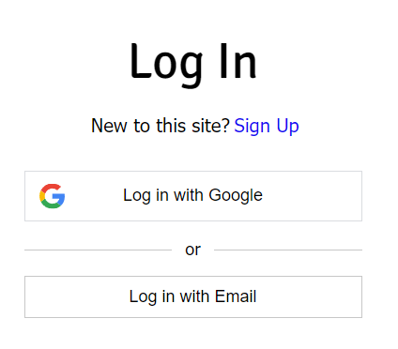
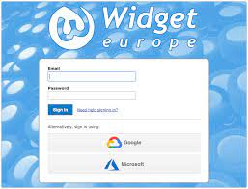
IDP – Identity Provider
Rohan
Portal
Trust Releation
Fiori Launchpad
SAML Token
Dedicated SRM
SAP IDP
SSO
SAP Service
It contains all the user id and passwords for all users and all systems,
It is a single source of truth for all the users in your company
Make security much easier for our company
Also contains permission, it knowns Who is who
Outlook
xsuaa backing service instance
My Microservice Spring App
XSUAA
www.anubhavtrainings.com

Slide 71

How it works behind the scenes
7
Sends Login Screen
Call IDP
IDP (Identity provider)
6
1
9
https://btpolingoodata-impressive-shark-nx.cfapps.us10-001.hana.ondemand.com/webapp/index.html
8
7
8
User credentials
10
Browser
6
SAML Token
2
12
4
9
JWT Token
Get me SAML token
JWT Token
10
Get me JWT token
3
5
SAML Token
11
Our Spring App
XSUAA
Every developer knows their application more than other, it’s the developer who decides what roles and permissions needed to access certain parts of the app. That is configured in a security configuration file called xs-security.json
BTP Platform
www.anubhavtrainings.com

Slide 72
What configuration we need for our app
/vendors – them to just authentication
/anubhav.svc/ - My Display role needs to be granted
/webapp/** - They need to have a Editor role in my app
We need to define these scopes in our xs-security file.
https://help.sap.com/docs/SAP_HANA_PLATFORM/4505d0bdaf4948449b7f7379d24d0f0d/6d3ed64092f748cbac691abc5fe52985.html
www.anubhavtrainings.com

Slide 73
Steps
To define the xs-security.json file as per the need of our project/application which contains the scopes.
Open SAP BTP cockpit and create a service instance of xsuaa, while creating the instance use the json file which defined the scope (xs-security.json).
Bind our service instance with our app, so when we deploy our app can connect to it to communicate to xsuaa. Go to manifest.yml file and add it as required resource.
Now we need to add security configuration to our app, which is done by looking at spring security samples provided by sap. In a java class we write matches rule to protect our end point. The sample implementation is provided by sap – check here documentation
We need to get all the dependencies needed for security integration
Use the sample provided by SAP and create a security folder with Security Configuration class.
Copy the sample code and define your antMatches (Rules) to control security at different levels.
Build and deploy the app.
All the instructions are in the txt file under additionalInfo folder in git project.
Testing
We try to call our end point with /vendors and we get an error
We add authorization type OAuth2.0 and provided the url/oauth/token, client id and client secret from our service binding service key
Obtain the JWT token in postman, use the token to resend the call
When we access service and web end points we created a role collection in BTP and assigned the role templates to our user.
www.anubhavtrainings.com

Slide 74
Title
<>
www.anubhavtrainings.com

Slide 75
Challenges in the Current XSUAA approach
Did you notice, that when we need to launch xsuaa instance and manually copy too much of details from service key
Pass all the information meticulously to the postman tool
Once token is expired the response wont come, and we need to reobtain the token manually again
Our end user do not know all these technicalities, We need to automate the XSUAA JWT token processing
In our app, we have multiple microservices, like Java, UI5, Node JS, XSUAA, the coordination between these services needs to be implemented because they all together runs our app.
Each service produce one end point like /Anubhav.svc, /index.html, /vendors, they are all belongs to same app but they all have different-different URL, to access our app, will your provide your user, these multiple URLs? We should have ONE url for entire app.
These microservices needs to communicate between each other also, we want to avoid a common issue while communicating to these API called CORS (Cross Origin Resource Sharing)
Current MS can only be tested using postman, as we have no coordination between ms, xsuaa and idp. We need a seamless login mechanism where the redirection should auto happen to IDP. All the SAML and XSUAA token exchanges must be done automatically.
We need a single entry point for our app. forwardAuthToken automatically.
IDP
App Router
Single Entry point | Exchange of tokens| Also work like a façade to allow communication between microservice
Consumer
Java
/Anubhav.svc
Java
/vendors
Fiori App
/webapp/index.html
xsuaa
www.anubhavtrainings.com

Slide 76
App Router
App router is a node js application
It is used to automate the process of authentication, authorization with XSUAA to perform all the token exchanges (SAML, JWT)
It sits in the middle of IDP and XSUAA, it will redirect the request of our microservice to XSUAA and eventually to IDP.
IDP sends the login screen to the user’s browser where user authenticate themselves, which in turn cause a SAML token issued by IDP, app router will take this token to XSUAA and catches the JWT token issued by UAA.
This JWT Token is then presented to our applications (Fiori, java, node js) so application will let us in.
App router is a single-entry point for our SaaS cloud application and it tracks the complete internal applications and microservices. It does it using a special file called xs-app.json
App router represented technically as a node module which is provided by SAP. @sap/approuter
www.anubhavtrainings.com

Slide 77



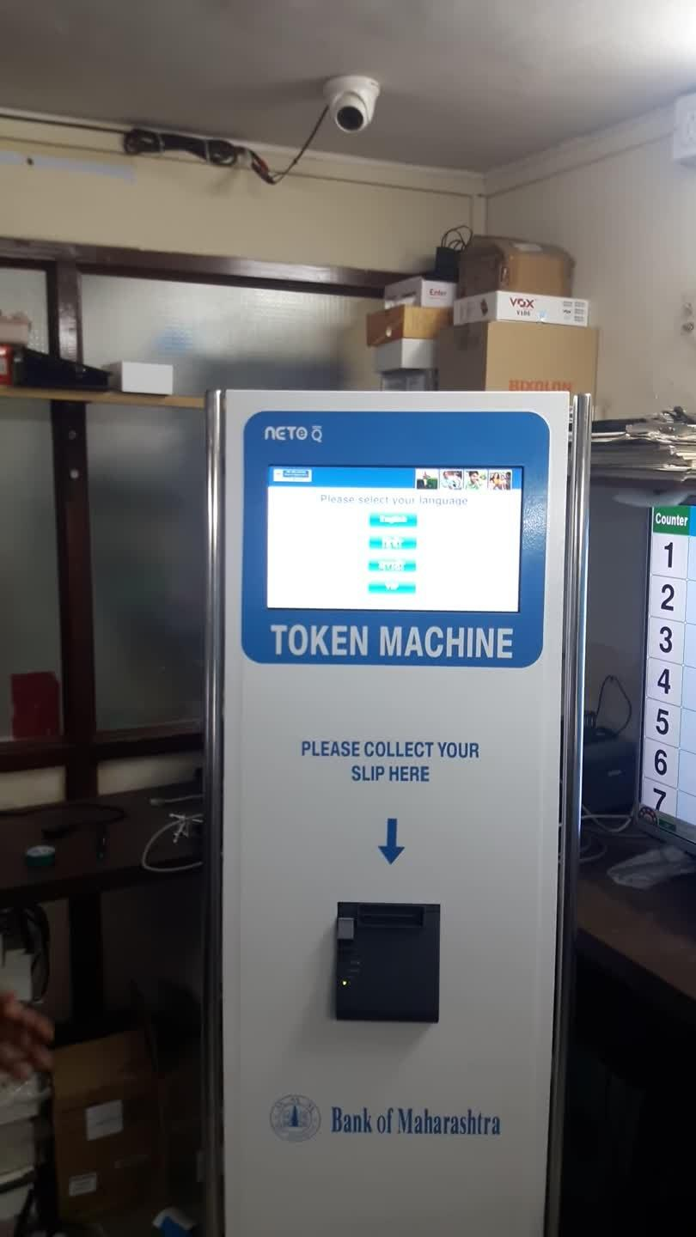
Real Life explanation of App Router
1
2
7
9
Loan
3
10
6
Gold Securities
Trust Relationship - Validate
Account Services
8
Lockers
4
5
FD
*********
Credit Card
www.anubhavtrainings.com

Slide 78
Client Server Architecture
Ryan Dyal
Extracts the engine which runs JS code in browser
Publish the engine + npm + libs = NODEJS
Framework to run JS code outside the browser
How the web application works over internet.
GET = Read data
POST = Create new data
PUT = Update Data
DELETE = Remove data
Java Script
Server
NodeJS
Client
(Browser)
GoogleV8
Request = header + body(optional)
PORT
Response = header + body
Body
XML
JSON
Text
HTML File
PDF, Word, Image, Stream
Java Script
ABAP
Java
Python
C++
www.anubhavtrainings.com

Slide 79
Node JS
Node JS is an open source, cross platform, Java script runtime environment and used to execute JS code outside the browser. Java and Java Script are completely different programming languages in their purpose, usage and design and nature. Java script is dominantly used to build web applications, but with arrival of Node JS, now a days we can build server side also using JS code.
https://nodejs.org/en/blog/release/v18.12.0
https://nodejs.org/dist/latest-v18.x/
Direct link -- https://nodejs.org/dist/latest-v18.x/node-v18.18.2-x64.msi
Node JS is great web framework for beginners because it works great with data-intensive applications like streaming, real-time apps, integration, social and business apps. Its free and easy to use with Java script.
What are the applications of JS programming?
Build server-side application logic
Send email, validate user input
Create microservices
Add automations
Build servers
Hosts web applications
Make pdf and word documents
DB lookups and updates
Your Java Code
Our Node JS Code
JRE
Node JS
pom.xml
maven
package.json
npm
www.anubhavtrainings.com

Slide 80
NPM – Node Package Manager
It is a dependency manager tool which gets installed automatically in our system when we install the node js. The recommended version of node js is 18.18.0 for this course. You can check the version of nodejs in command prompt after installation using node -v & npm –v
It is similar to maven for java. Just like maven have a online repository where developers and go and find the modules which they can download and reuse. The node has also a npm repository (https://npmjs.com)
These reusable objects on npmjs are called modules (package). The idea is to not re-invent the wheel.
We can download any node module and install them in our laptop or @ project level
When we want to use a module at system level (global) (usually CLIs)
npm install -g MODULE_NAME
2. When we want to use a module at project level (locally)
npm install MODULE_NAME
--a node_modules folder gets created storing all reusable modules for our project
When we built a java project. We saw pom.xml file which was containing all the dependencies (like spring, db drivers, Olingo). Similarly we have package.json for node js, which contains all the dependencies related to our node project. To create this file we use npm init command.
www.anubhavtrainings.com

Slide 81
Variables
Scalar variable
Array
Objects
Hold single value
Next assignment will overwrite previous value
E.g. x=10; x=20;
Hold multiple values of same data type, use []
Can be loop through
The first item of an array starts with index 0
We can check the size of the array – ARR.length
Hold multiple values of different data types – { }
Can be loop through
Like structure in abap, str-field here we use str.field
Syntax
{
“prop”: val,
“prop”: val,
“prop”: val
}
JSON – Java Script Object Notation
www.anubhavtrainings.com

Slide 82
Funda Fox
JS is a case-sensitive programming language
When we create variable in JS, we don’t need to provide the type of the variable, based on the value we assign, the variable data type will be detected automatically
Every statement in JS ends with semi-colon (;)
To create variables we can use var or let, the var creates a global variable in scope, let is used to create local scoped variable.
When we create variable and not assign value, it becomes null.
Any variable or function name in JS follows camel case naming convention. First letter of first word is small and next consecutive word’s first letter will be caps. E.g. wearelearningjs 🡺 weAreLearningJS
In JS = is assignment operator, == compares the values, === compares the values and data types
( ) – parenthesis { } – curly braces [ ] – bracket
JS also offers function syntax – anonymous function, named functions
JS is a asynchronous non-blocking IO programming
www.anubhavtrainings.com

Slide 83
Asynchronous Non Blocking IO
Browser
Server
asynchronously
callback function
Promise
www.anubhavtrainings.com

Slide 84
Step by Step Guide for Node MS
Create a new project directory
npm init to initialize node project
Create a file server.js and inculcate the code for building a webserver
Register our app, and a server end point
Start the server on a port in local machine for testing
Testing and add additional end points
While doing testing system will give an error that express was not found, so we need to download and install the express module from npmjs website. That is what managed by npm. npm install express
Begin testing again
--Anubhav sharing node project
When Anubhav creates and share node project, he will delete node_modules before sharing with you.
When you download the project in your VS code, just run npm install command which will scan package.json and download all node modules in your laptop also.
https://docs.cloudfoundry.org/devguide/deploy-apps/manifest-attributes.html
www.anubhavtrainings.com

Slide 85
Implementing App Router
App Router
@sap/approuter
xs-app.json
/Anubhav.svc
(java,spring,Olingo)
Browser
/static/index.html
(Fiori ui)
/employees.json
(nodejs based)
www.anubhavtrainings.com

Slide 86
Implementing App Router
Create a project for BTP with respective microservice folders
Copy paste java war file to javaapp folder
Copy paste node js application code to nodeapp folder
Copy paste Fiori app code from java to approuter/webapp
Initialize app router by installing @sap/approuter module and adding start script
Finally create manifest.yml to inform SAP BTP to deploy all apps together and define their roots
Define the configuration for these different end points in app router to route
We need to add xsuaa backing service and bind our instance with the same, so app router can exchange all the tokens. Use the xs-security.json file created by Anubhav in study material inside git.
Deploy our app to BTP which contains 3 microservices so called java, node, approuter(node) using cf login and cf push command.
www.anubhavtrainings.com

Slide 87
Title
<>
Sub account 1
Sub account 2
java
node
approuter
1 | sa1
2 | sa2
www.anubhavtrainings.com

Slide 88
Challenges of building BTP Native Cloud Apps
Resources available on internet are not very well organized for learning.
Multiple technologies being used which was kind of new for us and required learning curve
App router implementation was difficult 🡪 As a developer we spent lots of effort to setup the app router
In general, the complete project setup was so difficult with many files needs be added like manifest.yml, xs-security.json, xs-app.json which was a more of manual work a developer needs to do, even a small mistake in the file will cause my deployment to fail
It is not easy so far to find deployment issues and figure-out the problem while building the app
Are there some reference/sample apps/ best practice provided by SAP to build BTP Applications
We created our backing service instances manually
When it comes to a project, it needs files, dependencies, deployment descriptors, file formats and lots of boilerplate code and takes time to setup these things. Can we simplify this process?
How can we have lots of reusability in my project so we avoid the boilerplate code.
When we change database from postgresql to hana, we also changed many many lines of code in java application.
Our application and its code sometimes is tightly integrated with the DB, we want to avoid the same.
No matter what the functional you work whether MM, SD, FICO, CRM, APO, PLM, SRM, HR etc. Eventually as a developer we do same work. Design DB, Write business logic, add validations, checks, customizations, build UI.
How to develop software in BTP, what is the golden guideline (which architecture, which technology, which object to be kept where, how to deploy, manage effectively, change management, work for different scenarios, use cases)
When we build application on BTP, we want to build in a way that when we give or take handovers from colleagues, it should not take much time.
🡺 Standardization
www.anubhavtrainings.com

Slide 89
Frameworks in cloud
Framework – golden path for building application but not from scratch. Takes away boilerplate coding which every developer needs to do manually. A framework consists of a complete package of technologies, tooling, libraries, best-practices and coding standards, services.
In SAP BTP we have 2 such powerful frameworks provided by SAP
RAPM – Restful Application Programming Model
It is a framework to support ABAP in cloud. We can build extensions as well as new application in BTP using ABAP technology with restricted ABAP. It allows existing ABAP developers to on-board customer applications in BTP cloud. Since ABAP consultants are readily available in your team, you can opt for RAP framework.
CAPM – Cloud Application Programming Model
It’s a framework provided by SAP using open-source technologies (Java and Node). It utilizes SAP BTP’s Cloud Foundry environment to build multi-target applications based on microservice architecture. It is a great cost saving and choice of technology for developers who ready to take learning curve.
www.anubhavtrainings.com

Slide 90
CAPM – Cloud Application Programming Model
CAPM is a framework of
Languages – Java and Node JS
Libraries – Node modules which helps us avoid writing boiler plate code and generate most of the application artefacts for us
And Tools – VS Code and BAS
The framework can be used to build native cloud applications
Full stack application 🡺 database, application layer, service layer and UI layer
Extend existing application 🡺 Side by side extensibility using S/4HANA cloud SDK
UI
UI
UI
API
application
Application
CAPM
application
database
database
database
www.anubhavtrainings.com

Slide 91
Challenges of building DB
Many times developer end up using a technology which is tightly coupled to DB. Which means when we change database, we have re-write our entire application again.
If I have written 2mn SQL statements in our application, we end up re-writing all these statements again just to change database technology.
What we want?
To develop application in a way that we should not couple our app code tightly with DB. We want to develop in DB agnostic manner.
CREATE TABLE tab COLUMNS c1 int, c2 char;
CREATE TABLE tab COLUMNS
c1 : integer;
c2 : varchar length 30;
SQL Server
Oracle DB
www.anubhavtrainings.com

Slide 92
Core Data Services - CDS
CDS is a concept which allows us to get rid of SQL. It is an extension of SQL (what SQL can do, cds can also do). We need to create a design time artefact with an extension called .cds for almost everything e.g. database objects, services, ui’s. the CAPM framework will compile this file and generate the necessary statements and artefacts. CAP framework comes with a library called @sap/cds which is responsible for the compilation of cds artefacts. In order to use this library we need to install it at project level. CAPM also comes with the required tooling to generate your project skeleton, that is also comes with a library called @sap/cds-dk.
.cds
DB agnostic manner
https://cap.cloud.sap/docs/guides/databases-sqlite
Design time artefact
@sap/cds
Sql code
Run-time artefact
www.anubhavtrainings.com

Slide 93
Setup your first CAPM project
Open extensions in VS code and add the cds extension for CAPM in VS Code (for BAS it will be pre-configured)
We need to install sap cds development kit globally in system so we can use the cds command in our laptop. The kit includes required framework libraries and source code to design, develop, build, package, deploy, manage end to end lifecycle of capm based applications. It comes along with a cds CLI which provides cds command to us so that we can perform necessary tasks like creating project, binding project with backing services, compile the artefacts. If you using VS code you need to install this module, if we use BAS, its already pre-installed (NODE >= 18)
Install the cds dk library globally in the system – npm install -g @sap/cds-dk
Cross check if the installation was success – cds -v, cds --help
Create a application folder and go inside the folder to run cds init command
Just check the package.json for the modules it added automatically and perform npm install command
Create our first db design time object with .cds extension and add 2 tables to it
[optional]Test compilation - cds compile db/demo.cds -2 sql
Before we run lets deploy our tables to local fs based db sqlite 🡪 cds deploy --to sqlite
www.anubhavtrainings.com

Slide 94
Namespace
A namespace defines a unique name for our project artefacts. It helps us avoiding duplicate name definitions of our DB objects. It provide uniqueness to our project objects. For example in my company we have 2 cap projects one for FIN and one for HR which contains table employee. When we deploy the project namespace will provide a unique table name for each project separately.
www.anubhavtrainings.com

Slide 95
Types and Aspects
When we develop database objects, we would want to have lots of reusability, so we have less maintenance and also it takes less time to write the code. Like in SAP SE11 we have reusable data elements, domains and structures which we reuse to define table. In CAPM we have types for reusable data types and aspects as structures (combination of fields). We can include them to have great reusability.
To use an aspect use the tablename: aspectname, aspect2 {}
SAP also provides the standard aspects and types which can speedup our development process. They are present in a file @sap/commons
Temporal - valid dates
Managed – created by created on changed by changed on
Cuid – auto generate primary key
Currency – currency codes
www.anubhavtrainings.com

Slide 96
EPM Data Model
Enterprise Procurement Model (EPM) used to simulate real business.
ITeIO
Sales Order
Sales order items
Purchase Order
Purchase order items
Customers
Suppliers
Address
employees
1..1
Product Descriptions (texts)
Business Partners
1..*
Purchase orders
1..*
1..*
Purchase orders
Items
1..1
Products
www.anubhavtrainings.com

Slide 97
Text Tables
A text table is a table with same primary key as main table + Language as part of key to store language specific data.
Prod_texts_en
Product id | Name
P1 | Laptop
P2 | Web Camera
Prod_texts_de
Prod_texts_fr
Product id | Language | Name
P1 | EN | Laptop
P2 | EN | Web Camera
P1 | DE | ….
P2 | DE | …..
www.anubhavtrainings.com

Slide 98
Dev space in BAS tool
A dev space is a private development environment customized to cater to the needs of a specific sap development like Fiori app, capm, hybrid app (mdk), lcnc, workflow, simple web development, hana xsa. Dev space is a virtual machine running in the cloud on linux.
Optimum utilization of resources and memory in the cloud by creating a virtual machine.
In trial you can only spin 2 dev spaces and at a time only one can run
If you not use for 30-days, they will delete our dev space.
SAP auto configure this VM with required tools and frameworks for a development.
Clear isolation for any disruption.
Dev Space
VM -4GB
Dev Space
VM -4GB
Dev Space
VM -4GB
Dev Space
VM -4GB
BTP + BAS
USA (1000 GB)
www.anubhavtrainings.com

Slide 99
Git and git HUB
Common Challenges during the development of CAP applications
My CAP application was stable last night, I came to office this morning and made changes to my app, everything disrupted, now somehow I want to recover the state of last evening. So we need a local version management to rollback and commit changes somehow as a backup.
Anubhav, what is the best practice/gold standard to share my source code with fellow colleagues as the team is now growing.
Sharing the code as a zip file cannot be a solution for example if we have 40 developers in a team, at the end of the day we have 40 zip files, and merging them would be a big issue.
When something goes wrong in production, we want to know who’s change caused the disruption. We want to blame the correct concerned developer hence we need a centralized tracking of all the project changes.
When someone is on leave/vacation/permanently terminated, we need to catch the code which was developed in our company.
We have global team working from Mumbai, Denmark, Walldorf, Toronto, New York, Singapore, Delhi, they are working in different time zones, how can we sync our code together.
Git – git is a decentralized source code management system, will be used to manage and track your source code. This way developers can track their source code changes in any development environment. If you want to use git with vs code, you need to install git-scm from here
Git HUB – It is world’s largest source code repository used by billions. We can store any kind of code on git hub. It offers the remote repositories which allows us to share the source code with fellow colleagues. We can create public and private repository.
www.anubhavtrainings.com

Slide 100
Steps for using git
git init command to initialize a local repository
Create .gitignore file where you can list the folders which you don’t want to track
We add the files to staging area which we want git to track git add .
We need to commit changes which will push changes to the local repository
git commit -m “message”
You can go back to last stable state as git reset --hard
Local Repo
CAP project
BAS
Anubhav
Hello Pooja,
Here is the repository to start cap work
https://github.com/soyuztechnologies/sapbtp03_cap.git
Thanks,
Anubhav
master
git branch -M master
git remote add origin https://github.com/soyuztechnologies/sapbtp03_cap.git
git push -u origin master
GIT HUB Repository
Puja
git clone https://github.com/soyuztechnologies/sapbtp03_cap.git mycapapp
cd mycapapp
npm install
cds watch
www.anubhavtrainings.com

Slide 101
Services using CAP
By Default the CAP framework allows using our entities(db tables) and expose them as a service (odata service – version v4) and then we can use the same in integration, external application, internal Fiori application, plugins, API consumptions.
We can implement services other than our db tables also. These are known as custom end points. We always have a cds file for service definition and a .js file with same name as cds file (name equality) to have the implementation of the service.
We can test all the OData calls locally within the BAS tool using a local .http file.
www.anubhavtrainings.com

Slide 102
Performance of the app
Pagination – we use odata predicates $top and $skip to load data chunk by chunk.
www.anubhavtrainings.com

Slide 103
CDS Views
The data is distributed across multiple tables, and if we need to get this data, we end up writing complex data queries along with selection, joins, subqueries and conditions. This lead to high maintenance of queries in a longer run and a increased complexity. Views simplifies the process of data retrieval and easy to manage.
We can also perform aggregations on the view like SUM, MIN, MAX, COUNT, AVG. A view is build on top of another view which makes the data model completely reusable.
Security
CDS views are also contract for consumer to consume data offers meaningful names and alias.
We can add annotations in the cds views which drive additional features
The views provide a lose coupling between data so that the data is loaded on demand (lazy loading).
Sales orders
Sales orders Items
www.anubhavtrainings.com

Slide 104
Generic Handlers
The CAPM framework generates all the CURDQ code for us. It does not know the business rules/logic which needs to be customized as per our requirement. As a developer we want to attach some validations, pre-checks on data, post-checks on data, logging, tracing. To support all the extra logic on top of what CAPM already provides we can attach hooks using generic handlers. These operations will always be performed synchronously.
Use cases
Add validations before save happens
Overwrite complete CAPM code and take full control of logic
Write extra logic to add/delete data from our tables
Read extra data on top of GET which was handled by CAPM
When Trigger – on, before, after
For whom - Entity
What Operation – READ, UPDATE, CREATE
Logic – Business logic
Fiori app
odata
CAPM
Generic H.
Database
www.anubhavtrainings.com

Slide 105
Compatibility
www.anubhavtrainings.com

Slide 106
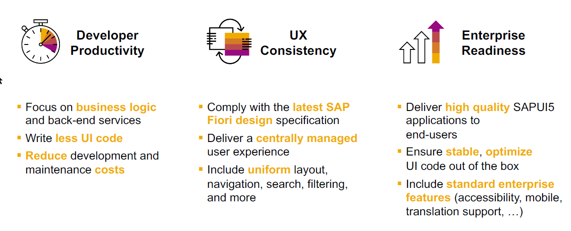
SAP Fiori elements boosts SAP Fiori development efficiency

Slide 107
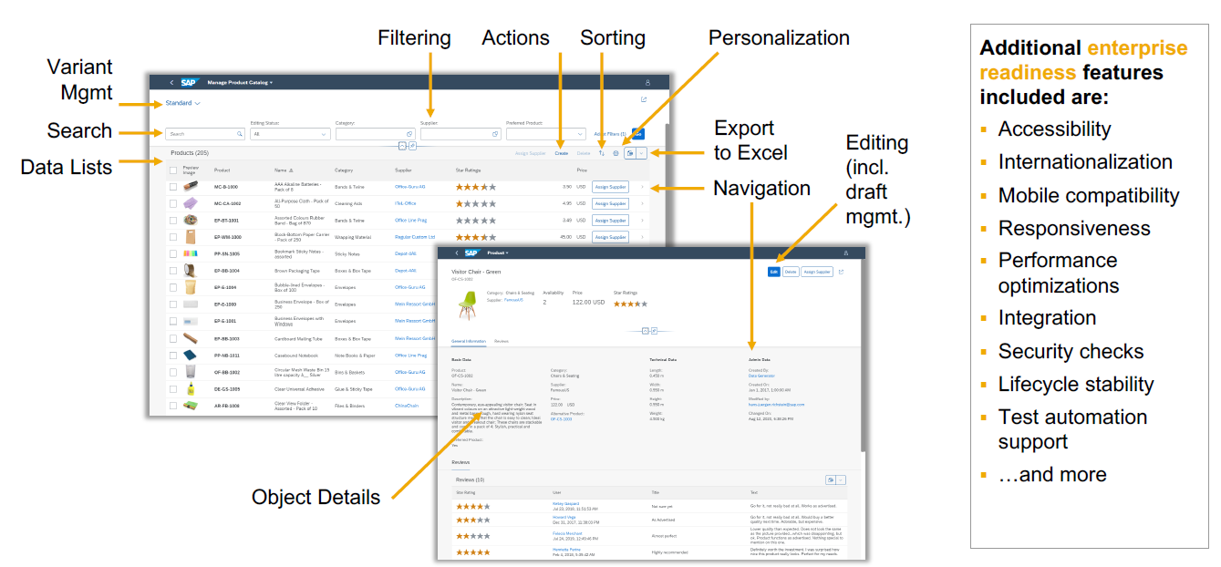
SAP Fiori elements provides enterprise-ready apps out of the box

Slide 108
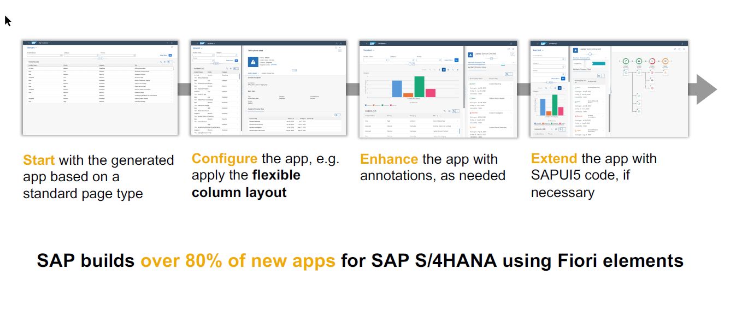
SAP Fiori elements application architecture provides flexibility

Slide 109

SAP Fiori elements prioritizes efficiency over flexibility

Slide 110
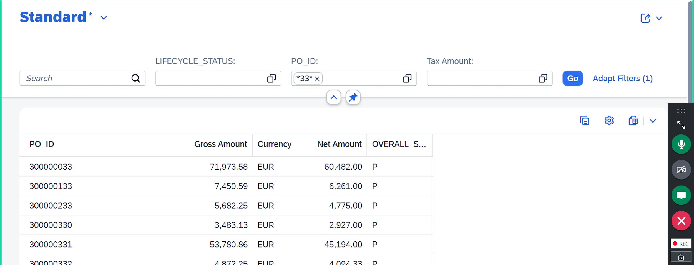
List Report App
https://ui5.sap.com/#/topic/609c39a7498541559dbef503c1ffd194.html
www.anubhavtrainings.com

Slide 111
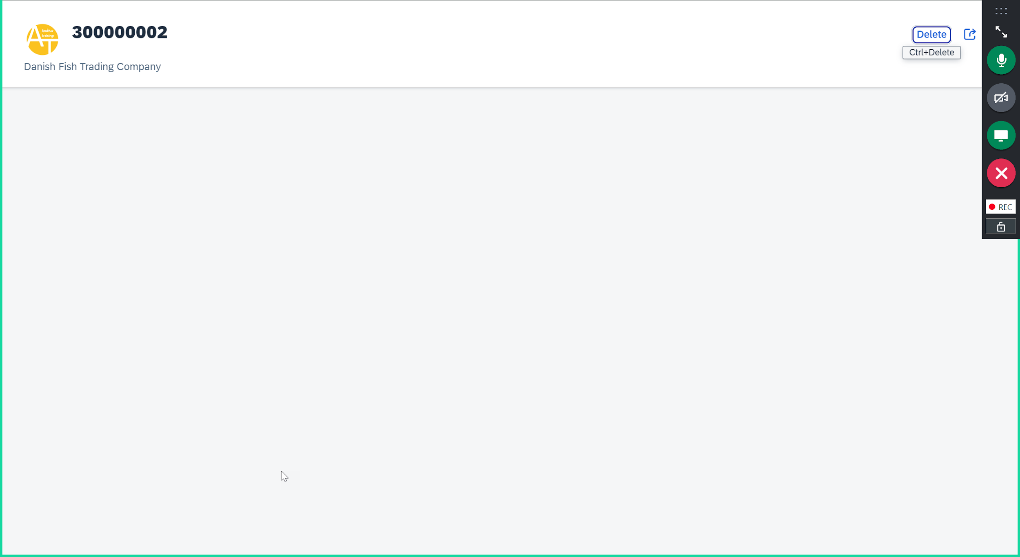
Object Page
<>
www.anubhavtrainings.com

Slide 112
Title
<>
www.anubhavtrainings.com

Slide 115
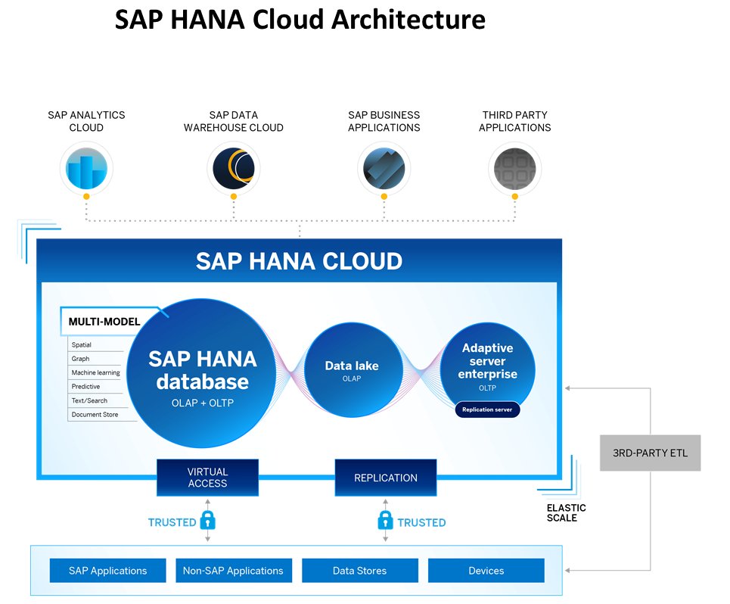
Introduction to HANA Cloud
https://www.youtube.com/watch?v=BlnTn7Ewifs
SAP HANA Cloud is a fully managed, in-memory, cloud database as a service (DBaaS). It is the cloud-based data foundation for SAP Business Technology Platform. With SAP HANA Cloud you can create, run, and extend new and existing applications.
SAP HANA Cloud includes a number of software components. The core component is SAP HANA Database, but other components can be added at any time, such as a data lake.
Key Components of SAP HANA Cloud
There are four key components of SAP HANA Cloud:
SAP HANA Cloud, SAP HANA Database
In-memory database with built-in advanced analytics (spatial, graph, text, etc.)
SAP HANA Cloud, data lake
Store and query large data sets and most file types
SAP HANA Cloud, adaptive server enterprise
Support for extreme –performance transactional applications
SAP HANA Cloud, adaptive server enterprise replication
Bi-directional real time data replication across databases

Slide 116
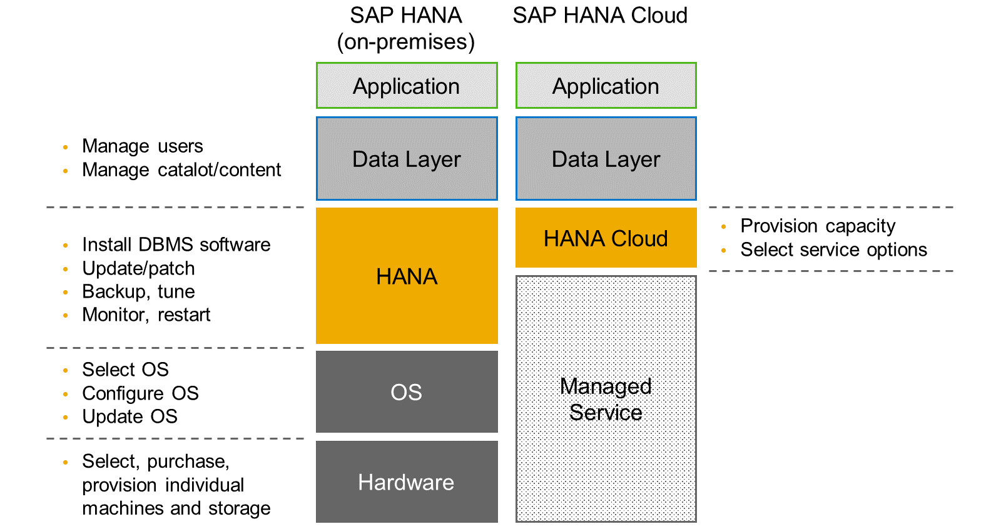
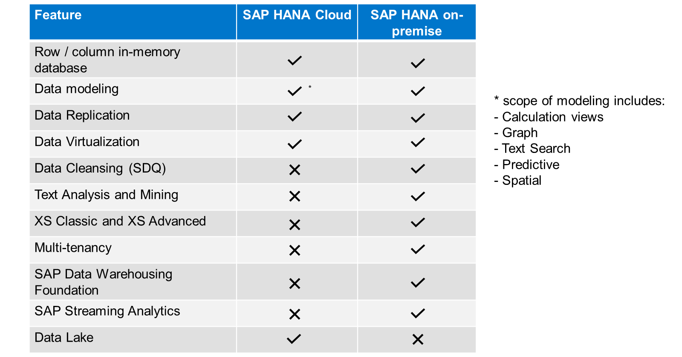
HANA Cloud v/s On-premise
Feature Differences
SAP HANA Cloud compares very closely with SAP HANA on-premise in terms of features but there are some differences.

Slide 117
Schema and HDI Containers
Schema – it is a mandatory database object present in every database on planet which has 3 main functions
- logical separation of database
- home of all the runtime objects in db
- manages the security of who can write, read, update, delete, truncate, insert data to db
MARA
MARA
MARA
SE11
SAP ECC
10GB
SAP BW
60GB
SAP S/4HANA
20GB
100GB->+100GB
SAPECC
Schema 1
SAPBWC
Schema 2
SAPS4H
Schema 3
MARA
MARA
MARA
www.anubhavtrainings.com

Slide 118
HDI Container
Is just like schema, it is a mandatory object. It is not managed by a person/developer, the application will manage it automatically. Since its managed by application, we don’t need to have a learning curve of HANA. It can be controlled by a service (backing service) called hdi container service. This service can manage schema automatically.
Our application bind to service and manage the container using same. HDI (HANA Deployment Infrastructure) service.
We can check our HDI Containers using a tool called SAP HANA Database Explorer tool. We cannot use the deprecated/outdated HANA Studio tool.
superman-key
CAP project
.cdsrc-private.json
superman
Dev Space – Linux machine
SAP HANA Cloud DB
superman
BAS
SAP BTP Platform
www.anubhavtrainings.com

Slide 119
Step by Step HANA
Add the SAP HANA Driver to our project and inform project that we want to use HANA now – cds add hana
Connect from our BAS tool to SAP BTP account so it can know that we have a HANA cloud DB is running – cf login
Create HANA specific files by compiling .cds to HANA format (.hdbtable) – cds build --production
We need now create container, backing service, and service key, and auto store this info in .cdsrc-private.json –
cds deploy --to hana:superman
www.anubhavtrainings.com

Slide 120
Adding Security to cap application
We need to include the desired node modules and xs-security.json file for applying security to our app cds add xsuaa
Defined desired permissions (scope) and role templates (which will be visible in BTP after deployment for our app) in xs-security.json file – Refer documentation here
We need to add specification to our service to only allow the authenticated users which provide valid credentials to access service end point (Autentication check)
We can further go to next level security at the level of our entity sets where we restrict the access of end points based on the roles. If someone have viewer role with particular bank name in the role, then only then can view the employee data for the particular banks. https://cap.cloud.sap/docs/node.js/authentication
Now we need to test our application in BAS tool to ensure that the security is working as expected. For that we will create a mock strategy for users to test our app.
Now if you check cds watch --profile hybrid the app will start with mock strategy to test security
Add the calls with mocked users in the http file and test auth, autho and row level auth
--app router
Open terminal cd app || npm init || npm install @sap/approuter
We configure the start script in package.json file inside app folder
Define the app router configuration in xs-app.json file
--Adding deployment descriptor
11. Now we add the deployment descriptor which will tell the sap btp about our application cds add mta
(mta.yml is an advance version of manifest.yml), it allows definition of all the modules and their dependencies (backing service). All the managed dependency instances will be created automatically @ the time of deployment to btp.
e.g. during java development we manually created xsuaa service instance in BTP cockpit, but this time system takes care of it automatically.
www.anubhavtrainings.com

Slide 121
Row level security
www.anubhavtrainings.com

Slide 122
Title
<>
www.anubhavtrainings.com

Slide 123
Title
<>
www.anubhavtrainings.com

Slide 124
Title
<>
www.anubhavtrainings.com

Slide 125
Open Question
Apart from HANA, can we also use postgres SQL database in CAP node BTP App, database profile
https://www.youtube.com/watch?v=zZckRSi9Sy8
I am trying to deploy mta file, but getting an error “your trial limit exceeded, please switch standard plan”
Use cf deploy mta_archieve/YOURMTAR_FILE_NAME
Can we build freestyle Fiori applications on top of CAPM and deploy on BTP – yes
Is it possible to show one example of freestyle cap application on top of cap odata – yes
If we want to build a stand alone Fiori application because in my company CAPM App (Services) are built by Denmark team, on top of It without touching their app, you want to build a FIORI app and deploy it to BTP can we do? – Yes
I have heard about SAP BTP Build Workzone, what is it, how to use it?
What is HTML5 Apps and HTML5 Repository in SAP BTP, my manager asked me to create a HTML5 Fiori App?
What is managed app router
I want to create multiple Fiori apps, but do not want to FLOOD/CONTAMINATE my CAP project with so many Apps inside, what is the best way to proceed?
Anubhav, you deployed the Fiori app like a NODEJS app, but what are the other ways we can deploy Fiori app in BTP.
Fiori App 1 (freestyle)
Fiori App 2 (freestyle)
CAPM Application
CatalogService.cds
/odata/v4/CatalogService/EmployeeSet
odata
Fiori App 3 (Fiori element)
Fiori App 4 (Fiori element)
www.anubhavtrainings.com

Slide 126
HTML5 Apps: Pros
We can use any popular web frameworks like React, Angular, UI5 (Fiori apps) etc.
It provides a good isolation from CAP project, hence if there is a change in UI, you don’t need to touch the CAP application. Imagine they sits in Denmark, your team sits in India.
In a global team, each team is responsible for their Fiori applications, they can work independently in their own environment with separate git repositories and lifecycle.
We need to add all these apps under single cap project, hence they can be developed, deployed, managed, transported individually.
We no need to make our CAP project bulkier
We can use managed app router, a app router managed by BTP platform, hence no need to configure our own app router, hence no memory consumption in BTP account, no complex module declaration or setup required.
Integrate with SAP Fiori Build workzone (aka SAP Fiori Central Launchpad) and make a tile of our app to be accessible using the single entry point.
These apps will live inside a repository in BTP called html5 repository.
www.anubhavtrainings.com

Slide 127
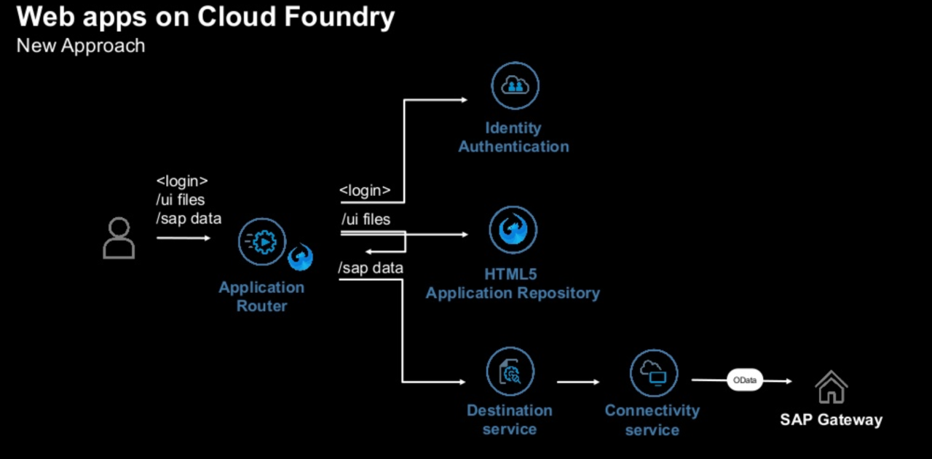
Serverless Fiori App Architecture
<>
www.anubhavtrainings.com

Slide 128
Backing services used for html5 apps
Destination – we need to create a destination to connect our Fiori app remotely to CAP service
Destination service – will be used by managed app router to read the destination and connect to our cap app service
XSUAA – will be responsible to authentication and authorization
HTML5 Repository Runtime – When our app is running in cloud, when user access our app, this service will serve our Fiori app files outside the html5 repository
[module] HTML5 Deployer – when you build application and deploy this app to BTP, this module will take all the code from BAS tool and deploy this to HTML5 REPOSITORY in BTP.
[subscription] SAP Build workzone – this is the launchpad which we give access to our user to access our app.
www.anubhavtrainings.com

Slide 129
Extension Use case
SAP BTP is the main technology platform for doing extensions of existing ERP applications in our company, that’s why this course is also called SAP BTP Extension suite training. The main pillers of an intelligent enterprise are:
Intelligent Suite – Solutions like S/4HANA, ECC etc.
Intelligent Platform – SAP BTP
Intelligent Technologies – SAC, SAP Build
If we want to extend our Software like ECC/S/4HANA, In the past we used to use extension options like BADI, Z/Y Reports, Custom programs, classes, built using ABAP technology, but these extensions will cause issues in longer run:
They are tightly coupled with ERP, if there an upgrade, there is an issue in SAP Standard software, our extension will break
Vice-versa, a extension which is improperly built, will break the upgrade
Risk on upgrades and the cost of upgrading software is very high
Have ability to contaminate SAP standard code
Overall the TCO and TCU will increase
SAP recommend us to build custom extensions outside ERP to have following benefits
Keep the core clean, it offers stable core ERP functionality
Clear separation between our development and SAP own code
Adapt new innovations in BTP faster
Not coupled with lifecycle of ERP and change request
SAP offers upgrade safe contract which will not change - APIs
Side-by-side extensions
In-app extensions
SAP BTP
S/4HANA
api
www.anubhavtrainings.com

Slide 130
Scenarios for Extension
www.anubhavtrainings.com

Slide 131
How to consume ERP Data
What is an API?
API stands for Application programming interface, it is the way to exchange data between systems, it’s a contract. Any SAP S/4HANA system offers out-of-box APIs which we can use to consume our ERP data/functionality from BTP.
SAP provide upgrade Safe APIs. Any upgrade to SAP system will not affect the contract of these APIs. SAP provides 3 kinds of APIs SOAP, OData (V2 and V4), REST
Where can I find them to consume data?
SAP provides a public portal – https://api.sap.com
We can also explore all APIs directly in the SAP system - /n/IWFND/MAINT_SERVICE, /n/IWFND/V4_ADMIN
For this training which S/4HANA system are we planning to use, if my company do not provide a system to practice, how can I learn with your training?
We will be using S/4HANA On-premise 2023 release.
Take server access from us – server@anubhavtrainings.com
40 USD / 2500 INR per month per user
This is S/4HANA OP license server available in public cloud. You don’t need any VPN to connect to our system.
SOAP v.s OData
https://www.youtube.com/watch?v=v_xPlRumdbE&pp=ygURc29hcCB2cyBvZGF0YSBzYXA%3D
www.anubhavtrainings.com

Slide 132
Connect to our SAP System
How to setup cloud connector
www.anubhavtrainings.com

Slide 133
Title
<>
SAP BTP Destination Properties
www.anubhavtrainings.com

Slide 134
2.1 Consume S/4HANA API in CAP
Fiori App
CAP Application
S/4HANA SDK (Module) to generate API calls as JS files (contract), Destination, XSUAA Service
S/4HANA System
(API – Sales Order)
SCC
Android App
destination
S/4HANA Cloud SDK
www.anubhavtrainings.com

Slide 135
Step by Step approach for Extension
Pre-requisites
You need to explore the API required for your integration on https://api.sap.com
Check if the CC and destination is configured to your OP system
BAS subscription / VS Code with modules installed
Register the OData service in backend S/4HANA System
Go to api.sap.com and download the Service specification – EDMX file
Steps
Create a new CAP project – s4hana-so-app and perform cds init
Start the empty app with cds watch and create a folder external under srv folder
Drag and drop the edmx file downloaded from api.sap.com to external folder, a csn file gets created in same folder
Install sap s/4hana cloud sdk - npm install @sap-cloud-sdk/generator
Generate the boilerplate code using s4hana cloud sdk to communicate to the s/4hana system sales order api
npx generate-odata-client --transpile --input srv/external --outputDir srv/src/generated
Create the CatalogService.cds for the definition of entity, Create CatalogService.js for invoking the API
Test the code by hardcoding the address of server with credentials, communicate to requestBuilder, and get data
Remove hardcoding and put destinationName, but it will not work in BAS tool because destination service is missing
Create destination service in BTP - cf create-service destination lite zkas
Create service key - cf create-service-key zkas zkas-key
Connect our project @ Design time to use the service so it can talk to destination cds bind --to zkas:zkas-key
www.anubhavtrainings.com

Slide 136
Step by Step approach for Extension
Add the new UI free style application connecting to V4 Service
Change routing and the view code to bind to entityset of odata and relative path
Test the UI application – cds watch --profile hybrid
Add the application router by going inside app folder cd app || npm init || npm install @sap/approuter
Create the app router configuration file touch xs-app.json and maintain the configuration
Add the support for xsuaa cds add xsuaa
Finally add the deployment descriptor cds add mta
Check the MTA is proper and build the MTA
Make sure you have started HANA instance as we have custom entity in our project
https://github.com/soyuztechnologies/s4hana-so-app
www.anubhavtrainings.com

Slide 137
Title
<>
www.anubhavtrainings.com

Slide 138
Title
<>
www.anubhavtrainings.com

Slide 139
CI/CD – Continuous integration/Delivery
Project
github
webhook
BAS
dev
prod
Pipeline (job)
Repository
Cloud Transport Service
SAP CI/CD service
SAP BTP
www.anubhavtrainings.com

Slide 140
Title
Native git action to implement CI/CD
https://www.youtube.com/watch?v=lIyATDhH1_w
Fiori testing framework
https://www.youtube.com/watch?v=WobPFaZAU2g&list=PLcxqFaocb9WLBaAmvuu4SX5o3yN0qkqGM
How to use Mongo DB with CAPM
https://www.youtube.com/watch?v=zXZf8kKM9NA&pp=ygUMY2FwbSBtb25nb2Ri
Can we use the Postgresql db with cap database as HANA cost is very high
https://www.youtube.com/watch?v=zZckRSi9Sy8&t=93s&pp=ygUWc2FwIGJ0cCBjYXAgcG9zdGdyZXNxbA%3D%3D
Event mash
https://www.youtube.com/watch?v=Q98BvpH0cKc&list=PL6RpkC85SLQATt7rdOTDUYRhtE4TQ7gG8
Certification exam – raj.shettyhyd@gmail.com
https://training.sap.com/course/cer006-sap-certification-exam-six-attempts-certification-online-010-in-ru/?
https://training.sap.com/certification/c_cpe_16-sap-certified-associate--backend-developer---sap-cloud-application-programming-model-g/?
www.anubhavtrainings.com

Slide 141
Title
<>
www.anubhavtrainings.com

Slide 142
www.anubhavtrainings.com
FAQs
Do I need to have prior knowledge of SAP BTP or Cloud Foundry?
No, We will cover the Cloud Foundry and BTP foundation in this course for you.
How much Java and Node knowledge is required to learn BTP Course?
Only Basic programming skills are required, We will cover basics of Java, Frameworks and Node JS for you along with Tools.
I am an ABAP Consultant, Can I learn SAP BTP ?
Yes, you must, because for all the future cloud projects, we need the knowledge of SAP BTP – Development Track
How much deep knowledge of BAS is required?
No prior experience is required, we will cover setup and administration of VS Code and BAS tool in the course.
What about server access?
The server is Free from SAP for 365 Days, We will use SAP BTP Trial Account for all the activities along with tools like Cloud Foundry CLI, VS Code, MBT which are free.
9

Slide 143
www.anubhavtrainings.com
FAQs
Do we also cover Cloud Connector and Cloud Application Security in the course?
Yes, we will cover both topics including application security like XSUAA, Managed and App Router, HTML Repos etc. We will cover concepts of Backing services, service keys and sap BTP cloud offerings.
How of this course do we spend time on CAPM?
We will spend almost 50% time on CAPM framework including basics of Node JS in the course.
Do I need prior OData Service experience?
No, we will provide one complimentary OData session
Can I also take the course in video mode as the times do not suit me?
Yes, You can even check the video after the class
What tools do I need to practice in the course?
Business Application Studio + VS Code + Cloud Foundry CLI.
How to join this course?
Email us at contact@anubhavtrainings.com for signing up!
10

Slide 144


Thank You
Email us : contact@anubhavtrainings.com
Call us: +91 8448454549
www.anubhavtrainings.com
Join us now for free demo!!

